Slide 1

HUB Nashville Data Analysis
November 5, 2019

Slide 2
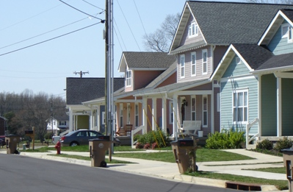
Metro Trash Collection
Metro and Contracted Collection
139,000 Customers
160 Routes
4 Days/Week
600 to 1000 Stops per Route

Slide 3
Contractual Liquidated Damages
Applies to both contractors
Allows deductions for:
Failure to clean-up spills
Failure to correct chronic problems (3 or more incidents at the same address)
NOTE: Metro defines the timeframe as 3 or more incidents at the same address over 6 months
Failure to provide service to an area, route or group of accounts

Slide 4
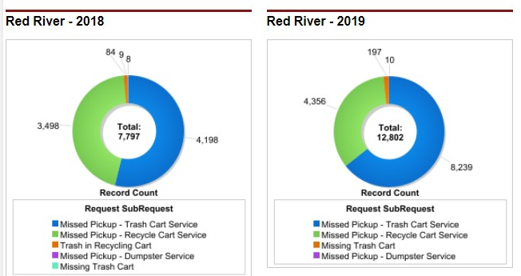
Contractor Trash Misses

Slide 5
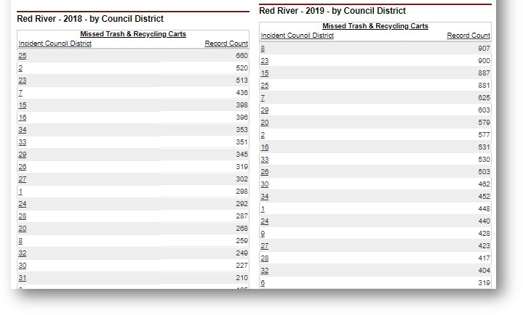
Contractor Trash Misses by Council District

Slide 6
Proposed Research
HUB data will be provided on Metro crews and both contractors (Red River and Waste Industries):
Trash Misses
Trash Collection Complaints
Property Damage
Public Works would like to have a method to:
Determine contractor performance for calculating any liquidated damages
Regularly compare data on Metro collection crews performance with contractor’s performance

Slide 7
Performance Measure Reports
Metro needs a methodology to easily run a report that will:
Identify repeated misses at the same address (3 or more) over a rolling 6 month period.
Calculate misses
Note and remove from calculation any overlapping misses from one month to the next so that any particular miss is not charged to the contractor more than once. At least one miss must be in the current month
Remove duplicate complaints (more than one complaint between the day trash was missed and next pickup day)
Identify instances where contractors missed an entire street, area or route in a month
Identify property damage, oil or hydraulic leaks in a month

Slide 8
Misses and Complaints
Data on misses will be relatively straightforward.
Data on complaints will need to identify if the complaint is:
Missed pickup
Property damage
Oil or hydraulic leaks
Other

Slide 9
Questions
Project Contacts
Stacy Jones – stacy.jones@nashville.gov
Erin Williams – erin.williams@nashville.gov
Sharon Smith – sharon.smith@nashville.gov

